Slide 1

String Algorithms
Preprocessing

Slide 2


Preprocessing: Naive algorithm
P
T
Naive exact matching
Results

Slide 3
Preprocessing:
P
Make lookup tables for bad character & good suﬃx rules
T
Boyer-Moore, KMP, …
Results

Slide 4
Preprocessing
T
P

Slide 5

Preprocessing
Algorithm that preprocesses T is oﬄine. Otherwise, algorithm is online.
T
Online or oﬄine?
Naïve algorithm
Boyer-Moore,…
Web search engine
Read alignment
P

Slide 6
Preprocessing
Algorithm that preprocesses T is oﬄine. Otherwise, algorithm is online.
T
Online or oﬄine?
Oﬄine?
Web search engine
Read alignment
P
Online
Naïve algorithm
Boyer-Moore, KMP, …

Slide 7

Oﬄine
Oﬄine algorithms
Online algorithms
Naive exact matching
???
Boyer-Moore, …

Slide 8

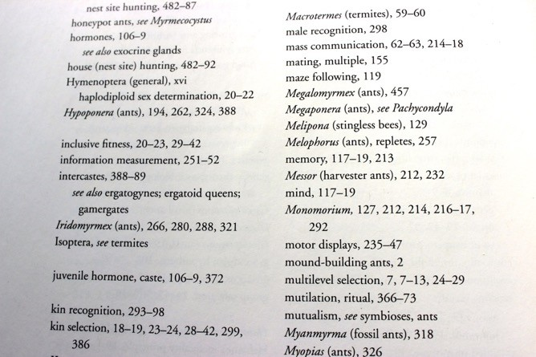

Index
Key terms ordered alphabetically, with associated page #s

Slide 9
Indexing DNA
Index of T
T: C G T G C G T G C T T

Slide 10
Indexing DNA
Index of T
C G T G C : 0
T: C G T G C G T G C T T

Slide 11
Indexing DNA
Index of T
C G T G C : 0
G T G C G : 1
T: C G T G C G T G C T T

Slide 12
Indexing DNA
 | Index | Of T
 | C G T G C : | 0
 | G T G C G : | 1
 | T G C G T : | 2
T: C G T G C G T G C T T

Slide 13
Indexing DNA
Index of T C G T G C : 0 G C G T G : 3 G T G C C : 1 T G C C T : 2
T: C G T G C G T G C T T

Slide 14
Indexing DNA
Index of T
C G T G C : | 0 , 4
G C G T G : | 3
G T G C C : | 1
T G C C T : | 2
T: C G T G C G T G C T T

Slide 15
Indexing DNA
Index of T
C G T G C : | 0 , 4
G C G T G : | 3
G T G C C : | 1
G T G C T : | 5
T G C C T : | 2
T: C G T G C G T G C T T

Slide 16
Indexing DNA
Index of T
C G T G C : | 0 , 4
G C G T G : | 3
G T G C C : | 1
G T G C T : | 5
T G C C T : | 2
T G C T T : | 6
T: C G T G C G T G C T T

Slide 17
Indexing DNA
k-mer: substring of length k
Index of T
C G T G C : | 0 , 4
G C G T G : | 3
G T G C C : | 1
G T G C T : | 5
T G C C T : | 2
T G C T T : | 6
5-mer index
T: C G T G C G T G C T T

Slide 18
Querying the index
Index of T
?
C G T G C : | 0 , 4
G C G T G : | 3
G T G C C : | 1
G T G C T : | 5
T G C C T : | 2
T G C T T : | 6
T: C G T G C G T G C T T
P: G C G T G C

Slide 19
Querying the index
Index of T
?
C G T G C : | 0 , 4
G C G T G : | 3
G T G C C : | 1
G T G C T : | 5
T G C C T : | 2
T G C T T : | 6
T: C G T G C G T G C T T
P: G C G T G C

Slide 20
Querying the index
Index of T
C G T G C : | 0 , 4
G C G T G : | 3
G T G C C : | 1
G T G C T : | 5
T G C C T : | 2
T G C T T : | 6
T: C G T G C G T G C T T
P: G C G T G C

Slide 21

Querying the index
Index of T C G T G C : 0 , 4 G C G T G : 3
G T G C C : 1 G T G C T : 5 T G C C T : 2 T G C T T : 6
T: C G T G C G T G C T T
P: G C G T G C

Slide 22

Querying the index
Index of T C G T G C : 0 , 4 G C G T G : 3
G T G C C : 1 G T G C T : 5 T G C C T : 2 T G C T T : 6
T: C G T G C G T G C T T
P: G C G T G C
Verification

Slide 23
Querying the index
Index of T C G T G C : 0 , 4 G C G T G : 3
G T G C C : 1 G T G C T : 5 T G C C T : 2 T G C T T : 6
T: C G T G C G T G C T T
P: G C G T G C
P occurs in T at offset 3

Slide 24
Querying the index
Index of T
?
C G T G C : | 0 , 4
G C G T G : | 3
G T G C C : | 1
G T G C T : | 5
T G C C T : | 2
T G C T T : | 6
T: C G T G C G T G C T T
P: G C G T G C

Slide 25
Querying the index
Index of T
C G T G C : | 0 , 4
G C G T G : | 3
G T G C C : | 1
G T G C T : | 5
T G C C T : | 2
T G C T T : | 6
T: C G T G C G T G C T T
P: G C G T G C

Slide 26


Querying the index
Index of T
C G T G C : | 0 , 4
G C G T G : | 3
G T G C C : | 1
G T G C T : | 5
T G C C T : | 2
T G C T T : | 6
T: C G T G C G T G C T T
P: G C G T G C

Slide 27
Querying the index
Index of T
C G T G C : | 0 , 4
G C G T G : | 3
G T G C C : | 1
G T G C T : | 5
T G C C T : | 2
T G C T T : | 6
T: C G T G C G T G C T T
P: G C G T G C
No match

Slide 28
Querying the index
Index of T
C G T G C : | 0 , 4
G C G T G : | 3
G T G C C : | 1
G T G C T : | 5
T G C C T : | 2
T G C T T : | 6
T: C G T G C G T G C T T
P: G C G T G C

Slide 29
Querying the index
Index of T
C G T G C : | 0 , 4
G C G T G : | 3
G T G C C : | 1
G T G C T : | 5
T G C C T : | 2
T G C T T : | 6
T: C G T G C G T G C T T
P: G C G T G C
P occurs in T at offset 3

Slide 30

Querying the index
Index of T
C G T G C : | 0 , 4
G C G T G : | 3
G T G C C : | 1
G T G C T : | 5
T G C C T : | 2
T G C T T : | 6
T: C G T G C G T G C T T
P: G C G T G A

Slide 31
Querying the index
Index of T C G T G C : 0 , 4 G C G T G : 3
G T G C C : 1 G T G C T : 5 T G C C T : 2 T G C T T : 6
T: C G T G C G T G C T T
P: G C G T G A

Slide 32
Querying the index
Index of T C G T G C : 0 , 4 G C G T G : 3
G T G C C : 1 G T G C T : 5 T G C C T : 2 T G C T T : 6
T: C G T G C G T G C T T
P: G C G T G A
P does not occur in T

Slide 33
Querying the index
Index of T
C G T G C : | 0 , 4
G C G T G : | 3
G T G C C : | 1
G T G C T : | 5
T G C C T : | 2
T G C T T : | 6
T: C G T G C G T G C T T
P: G C G T A C

Slide 34
Querying the index
Index of T
X
C G T G C : | 0 , 4
G C G T G : | 3
G T G C C : | 1
G T G C T : | 5
T G C C T : | 2
T G C T T : | 6
T: C G T G C G T G C T T
P: G C G T A C
P does not occur in T

Slide 35
Querying the index
Index of T
1 index hit
C G T G C : | 0 , 4
G C G T G : | 3
G T G C C : | 1
G T G C T : | 5
T G C C T : | 2
T G C T T : | 6
T: C G T G C G T G C T T
P: G C G T G C

Slide 36
Querying the index
Index of T
C G T G C : 0 , 4
2 index hits
G C G T G : 3 G T G C C : 1 G T G C T : 5 T G C C T : 2 T G C T T : 6
T: C G T G C G T G C T T
P: G C G T G C

Slide 37
Data structures
Index of T
C G T G C : | 0 , 4
G C G T G : | 3
G T G C C : | 1
G T G C T : | 5
T G C C T : | 2
T G C T T : | 6
Multimap
T: C G T G C G T G C T T

Slide 38


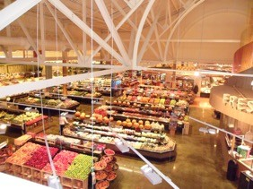
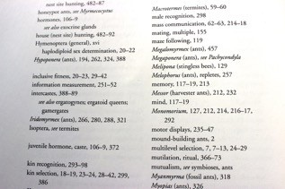
Data structures
ordering
grouping
Multimap
T: C G T G C G T G C T T

Slide 39
Data Structures
Ordering

Slide 40
Data structures
G T G 0
3-mer
T:
G T G C G T G T G G G G G

Slide 41
Data structures
G T G | 0
T G C | 1
T:
G T G C G T G T G G G G G

Slide 42
Data structures
G T G | 0
T G C | 1
G C G | 2
T:
G T G C G T G T G G G G G

Slide 43
Data structures
G T G | 0
T G C | 1
G C G | 2
C G T | 3
G T G | 4
T G T | 5
G T G | 6
T G G | 7
G G G | 8
G G G | 9
G G G | 10
T:
G T G C G T G T G G G G G

Slide 44
Data structures
C G T | 3
G C G | 2
G G G | 8
G G G | 9
G G G | 10
G T G | 0
G T G | 4
G T G | 6
T G C | 1
T G G | 7
T G T | 5
Alphabetical
by k-mer
T:
G T G C G T G T G G G G G

Slide 45
Data structures

Slide 46
Binary search
C G T | 3
G C G | 2
G G G | 8
G G G | 9
G G G | 10
G T G | 0
G T G | 4
G T G | 6
T G C | 1
T G G | 7
T G T | 5
T: G T G C G T G G G G G
P: G C G T G G

Slide 47
Binary search
C G T | 3
G C G | 2
G G G | 8
G G G | 9
G G G | 10
G T G | 0
G T G | 4
G T G | 6
T G C | 1
T G G | 7
T G T | 5
T G G > G T G
T: G T G C G T G G G G G
P: G C G T G G

Slide 48
Binary search
G T G | 4
G T G | 6
T G C | 1
T G G | 7
T G T | 5
C G T 3
G C G 2
G G G 8
G G G 9 G G G 10 G T G 0
After 1st bisection
T G G > T G C
T: G T G C G T G G G G G
P: G C G T G G

Slide 49
Binary search
T G G | 7
T G T | 5
C G T 3
G C G 2
G G G 8
G G G 9 G G G 10 G T G 0
G T G 4
G T G 6
T G C 1
After 2nd bisection
T G G = T G G
T: G T G C G T G G G G G
P: G C G T G G

Slide 50
Binary search
~ log2(n) bisections per query
n
...

Slide 51
Data Structures
Grouping

Slide 52
Hash table
∅
∅
∅
∅
∅
∅
∅
∅
∅
∅
∅
Hash function h maps 3-mers to buckets
Buckets
T: G T G C G T G T G G G G G

Slide 53


∅
∅
∅
∅
∅
∅
GTG
0
h(TGC)
T: GTGCGTGTGGGGG

Slide 54
TGC
1
∅
∅
∅
∅
∅
∅
∅
GTG
0
h(TGC)
T: GTGCGTGTGGGGG

Slide 55
TGC
1
∅
∅
∅
∅
∅
∅
∅
GTG
0
h(GCG)
GCG
2
T: GTGCGTGTGGGGG

Slide 56
TGC
1
∅
∅
∅
∅
∅
∅
∅
GTG
0
CGT
3
h(CGT)
GCG
2
T: GTGCGTGTGGGGG

Slide 57
TGC
1
∅
∅
∅
∅
∅
∅
∅
GTG
0
G TG
4
CGT
3
h(GTG)
GCG
2
T: GTGCGTGTGGGGG

Slide 58
TGC
1
∅
∅
∅
∅
∅
∅
∅
GTG
0
G TG
4
CGT
3
h(TGT)
GCG
2
TGT
5
∅
Collision!
T: GTGCGTGTGGGGG

Slide 59
TGC
1
∅
∅
∅
∅
∅
∅
∅
GTG
0
G TG
4
GTG
6
∅
CGT
3
h(GTG)
GCG
2
TGT
5
∅
T: GTGCGTGTGGGGG

Slide 60
TGC
1
∅
∅
∅
∅
∅
∅
∅
TGG
7
∅
GTG
0
G TG
4
GTG
6
∅
CGT
3
h(TGG)
GCG
2
TGT
5
∅
T: GTGCGTGTGGGGG

Slide 61
TGC
1
∅
∅
∅
∅
∅
∅
∅
TGG
7
∅
GTG
0
G TG
4
GTG
6
∅
CGT
3
GGG
8
Collision!
h(GGG)
GCG
2
TGT
5
∅
T: GTGCGTGTGGGGG

Slide 62
TGC
1
∅
∅
∅
∅
∅
∅
∅
TGG
7
∅
GTG
0
G TG
4
GTG
6
∅
CGT
3
GGG
8
GGG
9
∅
h(GGG)
GCG
2
TGT
5
∅
T: GTGCGTGTGGGGG

Slide 63
TGC
1
∅
∅
∅
∅
∅
∅
∅
TGG
7
∅
GTG
0
G TG
4
GTG
6
∅
CGT
3
GGG
8
GGG
9
GGG
10
∅
h(GGG)
GCG
2
TGT
5
∅
T: GTGCGTGTGGGGG

Slide 64
TGC
1
∅
∅
∅
∅
∅
∅
∅
TGG
7
∅
GTG
0
G TG
4
GTG
6
∅
CGT
3
GGG
8
GGG
9
GGG
10
∅
h(GGG)
GCG
2
TGT
5
∅
T: GTGCGTGTGGGGG

Slide 65
TGC
1
∅
∅
∅
∅
∅
∅
∅
TGG
7
∅
GTG
0
G TG
4
GTG
6
∅
CGT
3
GGG
8
GGG
9
GGG
10
∅
h(GGG)
GCG
2
TGT
5
∅
T: GTGCGTGTGGGGG
P: TGTGGG

Slide 66
TGC
1
∅
∅
∅
∅
∅
∅
∅
TGG
7
∅
GTG
0
G TG
4
GTG
6
∅
CGT
3
GGG
8
GGG
9
GGG
10
∅
h(GGG)
GCG
2
TGT
5
∅
T: GTGCGTGTGGGGG
P: TGTGGG

Slide 67
TGC
1
∅
∅
∅
∅
∅
∅
∅
TGG
7
∅
GTG
0
G TG
4
GTG
6
∅
CGT
3
GGG
8
GGG
9
GGG
10
∅
h(GGG)
GCG
2
TGT
5
∅
T: GTGCGTGTGGGGG
P: TGTGGG

Slide 68
TGC
1
∅
∅
∅
∅
∅
∅
∅
TGG
7
∅
GTG
0
G TG
4
GTG
6
∅
CGT
3
GGG
8
GGG
9
GGG
10
∅
h(GGG)
GCG
2
TGT
5
∅
T: GTGCGTGTGGGGG
P: TGTGGG

Slide 69
TGC
1
∅
∅
∅
∅
∅
∅
∅
TGG
7
∅
GTG
0
G TG
4
GTG
6
∅
CGT
3
GGG
8
GGG
9
GGG
10
∅
h(GGG)
GCG
2
TGT
5
∅
T: GTGCGTGTGGGGG
P: TGTGGG

Slide 70
TGC
1
∅
∅
∅
∅
∅
∅
∅
TGG
7
∅
GTG
0
G TG
4
GTG
6
∅
CGT
3
GGG
8
GGG
9
GGG
10
∅
h(GGG)
GCG
2
TGT
5
∅
Index hits at offsets 8, 9 &10
T: GTGCGTGTGGGGG
P: TGTGGG

Slide 71
Index of T
C G T G C : | 0 , 4
G C G T G : | 3
G T G C C : | 1
G T G C T : | 5
T G C C T : | 2
T G C T T : | 6
T: CGTGCGTGCTT

Slide 72
Index of T
C G T G C : | 0 , 4
G C G T G : | 3
G T G C C : | 1
G T G C T : | 5
T G C C T : | 2
T G C T T : | 6
T: CGTGCGTGCTT
Notes:
What if we take only even

Slide 73
Index of T
C G T G C : | 0 , 4
T G C C T : | 2
T G C T T : | 6
T: CGTGCGTGCTT
Notes:
What if we take only even

Slide 74
Index of T
C G T G C : | 0 , 4
T G C C T : | 2
T G C T T : | 6
T: CGTGCGTGCTT
P: GCGTGCTT
Notes:
What if we take only even

Slide 75
Index of T
C G T G C : | 0 , 4
T G C C T : | 2
T G C T T : | 6
X
T: CGTGCGTGCTT
P: GCGTGCTT
Notes:
What if we take only even

Slide 76
Index of T
C G T G C : | 0 , 4
T G C C T : | 2
T G C T T : | 6
T: CGTGCGTGCTT
P: GCGTGCTT
Notes:
What if we take only even

Slide 77
T:
Index: all even
P:
even
Query:
odd

Slide 78
T:
Index: all even
P:
even
Query:
odd

Slide 79
T:
Index: every 3rd
P:
0
Query:
1
2

Slide 80
T:
Index: every 3rd
P:
0 mod 3
Query:
1 mod 3
2 mod 3

Slide 81

string of characters also occurring in S
in the same order
Subsequence of S
>>> seq = 'AACCGGTT'
>>> seq[0] + seq[1] + seq[5] + seq[7] 'AAGT' # subsequence
>>> seq.find('AAGT')
-­‐1 # not a substring
Substrings are also subsequences, subsequences are not necessarily substrings

Slide 82
Index of T
C G G G T : 0
T: C G T G C G T G C T T

Slide 83
Index of T
C G G G T : 0
G T C T G : 1
T: C G T G C G T G C T T

Slide 84
Index of T
C G G G T : 0 G T C T G : 1 T G G G C : 2
T: C G T G C G T G C T T

Slide 85
Index of T
C G G G T : | 0
C G G T T : | 4
G C T C T : | 3
G T C T G : | 1
T G G G C : | 2
T: C G T G C G T G C T T

Slide 86
Index of T
C G G G T : | 0
C G G T T : | 4
G C T C T : | 3
G T C T G : | 1
T G G G C : | 2
T: C G T G C G T G C T T
P: G C G T A C T

Slide 87
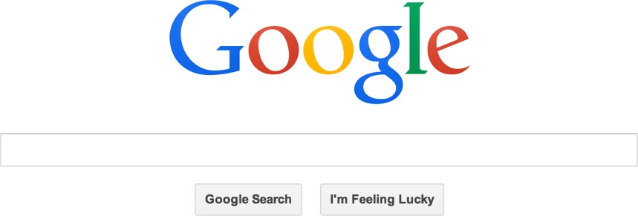
Indexing

Slide 88
Indexing
Index of T
C G T G C : | 0 , 4
G C G T G : | 3
G T G C C : | 1
G T G C T : | 5
T G C C T : | 2
T G C T T : | 6
T: C G T G C G T G C T T

Slide 89
Indexing subsequences
Index of T
C G G G T : 0 G T C T G : 1 T G G G C : 2
T: C G T G C G T G C T T

Slide 90
Suffix Index

Slide 91
Suﬃx Index
T:
GTTATAGCTGATCGCGGCGTAGCGG
GTTATAGCTGATCGCGGCGTAGCGG
TTATAGCTGATCGCGGCGTAGCGG
TATAGCTGATCGCGGCGTAGCGG
ATAGCTGATCGCGGCGTAGCGG
TAGCTGATCGCGGCGTAGCGG
AGCTGATCGCGGCGTAGCGG
GCTGATCGCGGCGTAGCGG
CTGATCGCGGCGTAGCGG
TGATCGCGGCGTAGCGG
GATCGCGGCGTAGCGG
ATCGCGGCGTAGCGG
TCGCGGCGTAGCGG
CGCGGCGTAGCGG
GCGGCGTAGCGG
CGGCGTAGCGG
GGCGTAGCGG
GCGTAGCGG
CGTAGCGG
GTAGCGG
TAGCGG
AGCGG
GCGG
CGG
GG
G
$
$
$
$
$
$
$
$
$
$
$
$
$
$
$
$
$
$
$
$
$
$
$
$
$
$
$

Slide 92
Suﬃx Index
T = abaaba abaaba baaba aaba aba
ba
a
a aaba aba abaaba
ba baaba
Alphabetical order

Slide 93
Suﬃx Index
Querying uses binary search
a aaba aba
abaaba ba baaba
P = ab

Slide 94
Suffix Index
GTTATAGCTGATCGCGGCGTAGCGG
T:
GTTATAGCTGATCGCGGCGTAGCGG
TTATAGCTGATCGCGGCGTAGCGG
TATAGCTGATCGCGGCGTAGCGG
ATAGCTGATCGCGGCGTAGCGG
TAGCTGATCGCGGCGTAGCGG
AGCTGATCGCGGCGTAGCGG
GCTGATCGCGGCGTAGCGG
CTGATCGCGGCGTAGCGG
TGATCGCGGCGTAGCGG
GATCGCGGCGTAGCGG
ATCGCGGCGTAGCGG
TCGCGGCGTAGCGG
CGCGGCGTAGCGG
GCGGCGTAGCGG
CGGCGTAGCGG
GGCGTAGCGG
GCGTAGCGG
CGTAGCGG
GTAGCGG
TAGCGG
AGCGG
GCGG
CGG
GG
G
n(n+1)/2 ≈ (n²)/2 chars
Human genome n ≈ 3 billion
n² ≈ (3 x10⁹)²
n² ≈ 9 x10¹⁸

Slide 95

Suﬃx index
T = abaaba
5
2
3
0
4
1
a aaba aba
abaaba ba baaba
Suﬃx array is m
integers long
SuﬃxArray(T )

Slide 96
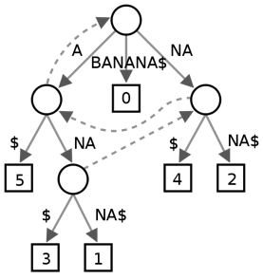
6
5
3
1
0
4
2
$
A$
ANA$ ANANA$ BANANA$
NA$ NANA$
$BANANA
A$BANAN
ANA$BAN
ANANA$B
BANANA$
NA$BANA
NANA$BA
Suﬃx Tree
Suﬃx Array
FM Index
Borrows wheeler transform
Grouping
Ordering

Slide 97
6
5
3
1
0
4
2
$
A$
ANA$ ANANA$ BANANA$
NA$ NANA$
$BANANA
A$BANAN
ANA$BAN
ANANA$B
BANANA$
NA$BANA
NANA$BA
Suﬃx Tree
Suﬃx Array
FM Index
≥ 45 GB
≥ 12 GB
~ 1 GB
Indexing Entire Human Genome

